Slide 1
Senior Design: Steam Heat Controller
Team Members: Curtis Mayberry, Ben Cao,
Thinh Luong, Ben Jusufovic
Advisors: Lee Harker, Jason Boyd

Slide 2
Overview
Problem Statement
Constraints
High-level Design
Expected deliverables
Possible Issues
Budget
Schedule

Slide 3
Problem Statement
Currently, the old section of Coover utilizes steam valves in order to heat adjacent rooms. In extreme cases, one steam valve controls the temperature in five different rooms through five radiators. This leads to temperature offset in the rooms and continuous adjustment of the valve in order to accommodate the individuals within each room.

Slide 4
Constraints
Temperature Sensors controlled by wireless
Mechanical implementation
Temperature differentiation between rooms
Financial budget: $1000 (not finalized)
Plant restrictions (heat output)

Slide 5
High-level Design
Mechanical system
Wireless interface between temperature sensor and controller
PID Temperature Controller
Network interface
Room temperature profiling
Temperature sensor located in control panel
LCD user interface
building profiling
Interface with Johnston Control equipment?

Slide 6
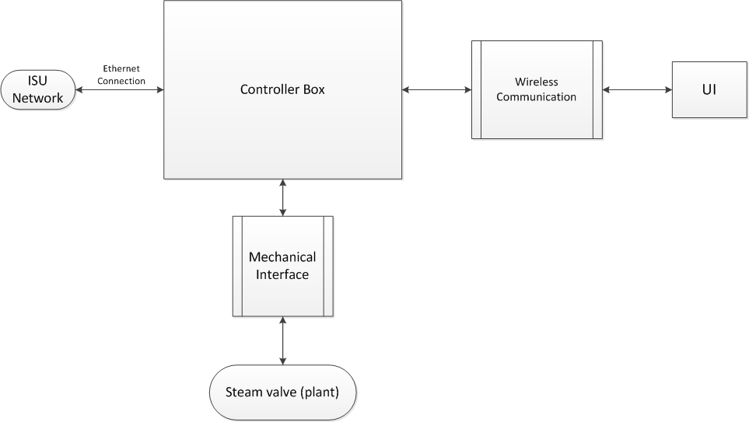
Overall Design

Slide 7
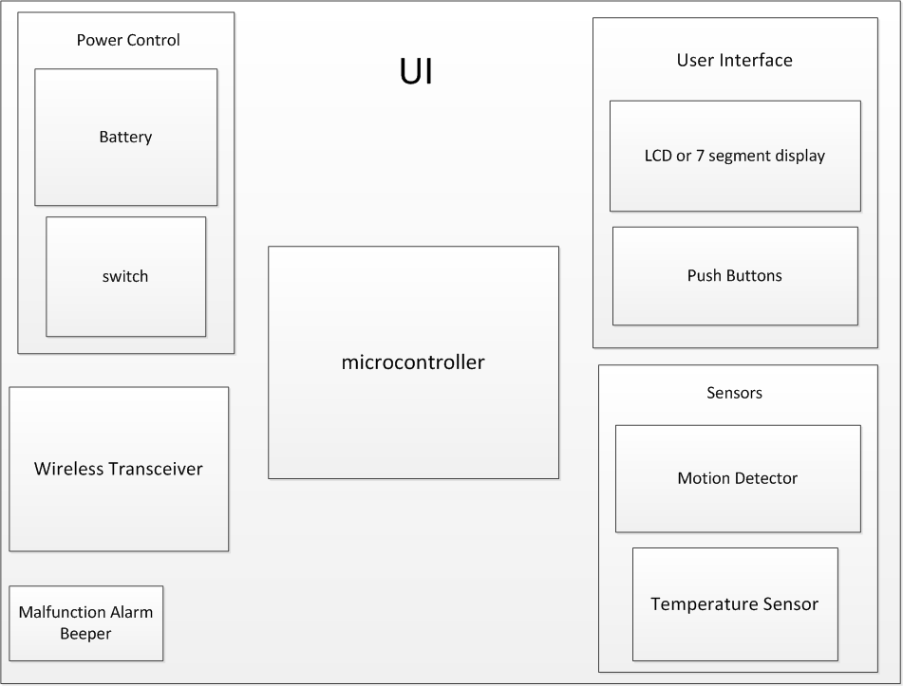
User Interface

Slide 8
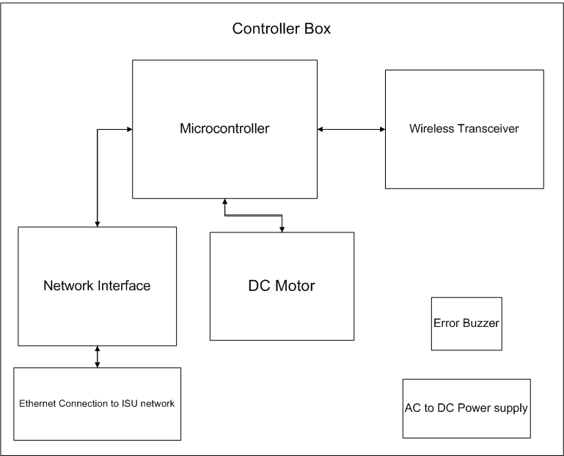
Controller Box

Slide 9
Expected Deliverables
One controller per valve
Ability to communicate through ISU network
Functional control panel
LCD interface
Communicate with controller
One temperature sensor per room

Slide 10
Possible Issues
Conflicting Temperature Preferences
2 to 5 rooms with multiple control panels
Limited mechanical experience
Part’s lead time
Need an adaptable system
Variety of environments

Slide 11
Controller Box Budget
Notes:
Change caps and resis

Slide 12
Control Panel Budget
Notes:
Change from prototype to production cost for PCB – Green benefits?

Slide 13
Total Cost Estimate
Notes:
Calculate per hour based on salary
Use generic 802.15 protocal

Slide 14
Gantt Chart

Slide 15
Tracking Our Progress
https://spreadsheets.google.com/viewform?formkey=dFE5Qk1aaGVuNXJfNjgwUW4zbTZ2ZFE6MQ

Slide 16

Questions?

